Slide 1


BIRLA INSTITUTE OF TECHNOLOGY, DEOGHAR
Canteen Management System
Presented by
Guided by
Jagmohan Mishra (BCA/60001/20)
Prem Raj (BCA/60002/20)
Shivam Vishwakarma (BCA/60003/20)
Dr. K.N Mishra
Submitted for the partial fulfillment of
Bachelor of Computer Application

Slide 2
Content
Problem Statement
Purpose
Objectives
UML Diagram
Design Front End
Tools and technologies
Canteen Management System
2

Slide 3
1. Problem Statement
Poor delivery of food service.
Waiting in line for order confirmation.
Cash and Paper based
Wait for exact amount of cash change
Biased Coupon system
Canteen Management System
3

Slide 4
2. Purpose
Fast Delivery
Dynamic Order Price
Friendly Gui
Save admin & user’s time
Solution for Chaos

Slide 5

Continued
What is CMS ?
Food Ordering System which enables end user to select and order food online.
What is Management?
The process of making system digitally operable.
Canteen Management System
5

Slide 6

How is this useful in real world?
Customer:
Can Customize combos
Can see Transaction details
Owner can:
Up-to-date menu with images.
Manage Orders with time

Slide 7
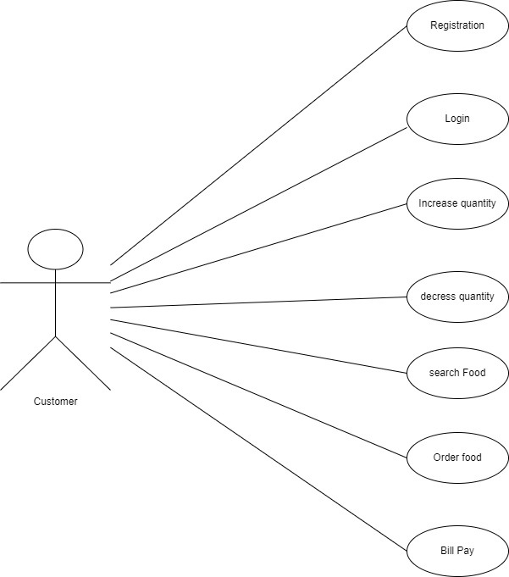
3. UML Diagrams
USE CASE : CUSTOMER

Slide 8
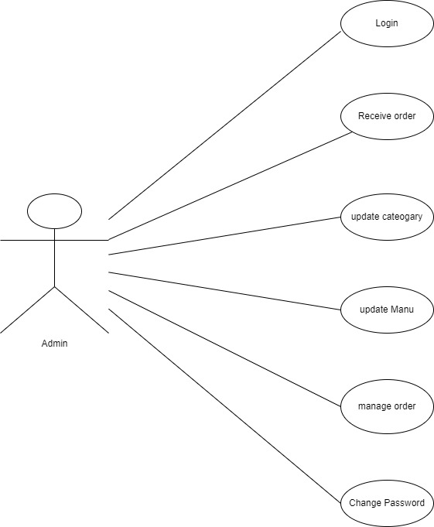
USE CASE : Admin

Slide 9
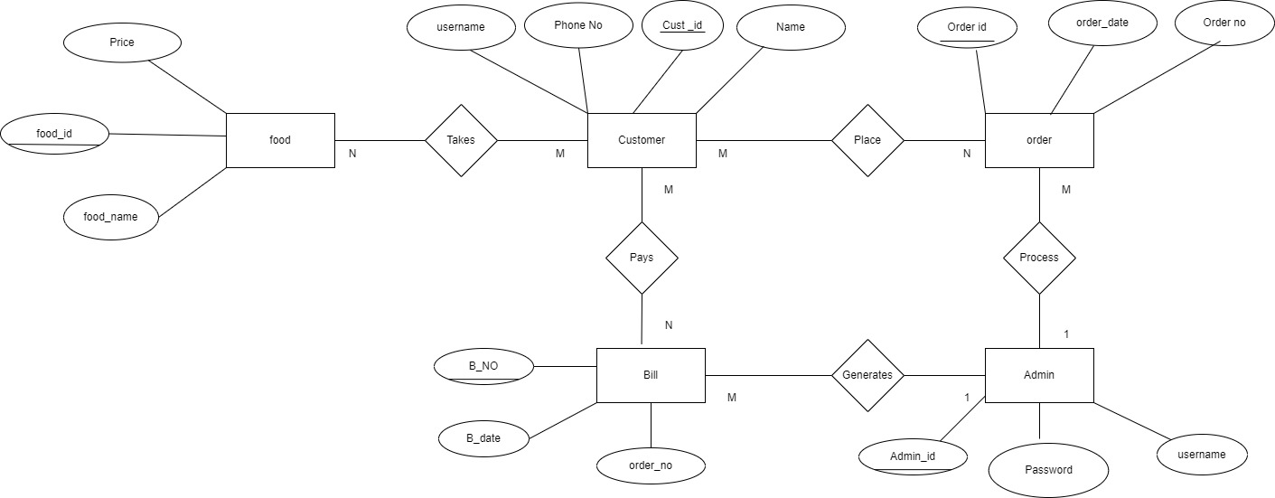
ER DIAGRAM : Canteen Management

Slide 10
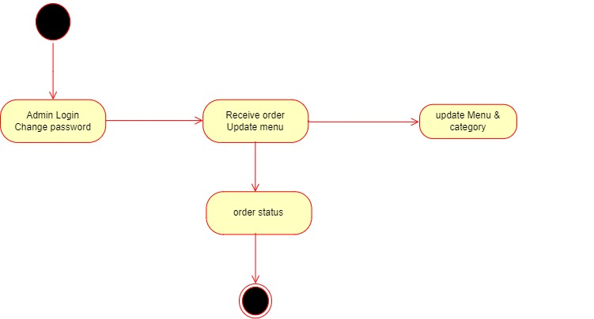
STATE CHART : Admin Login and Registration
START
END

Slide 11
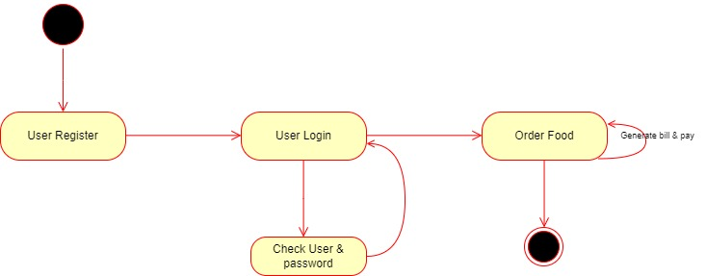
STATE CHART : User Login and Ordering
START
END

Slide 12
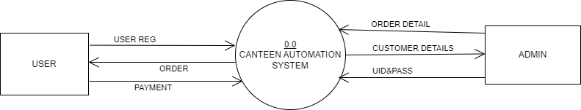
DFD : 0 LEVEL

Slide 13
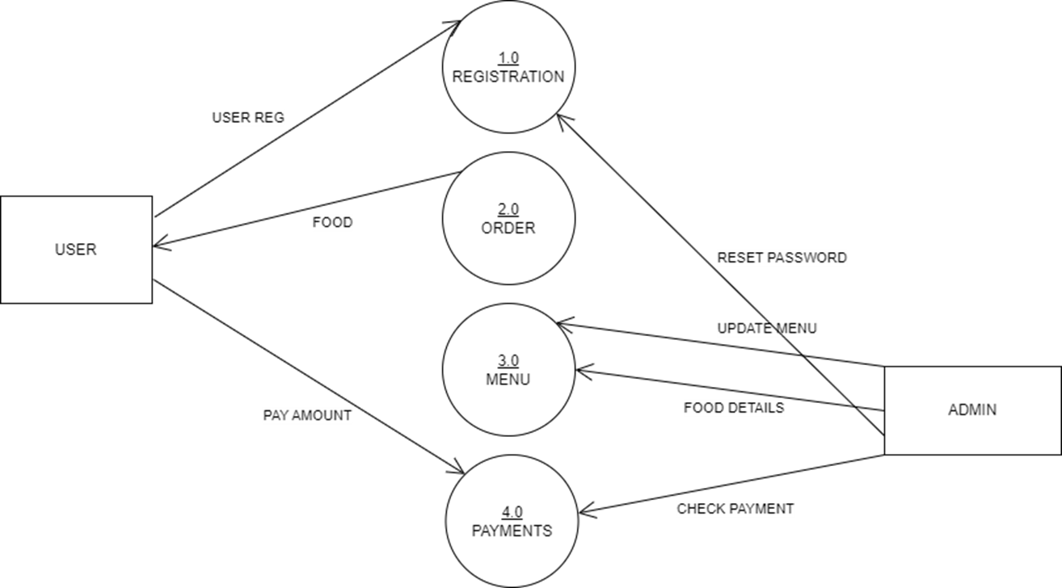
DFD : 1 LEVEL

Slide 14
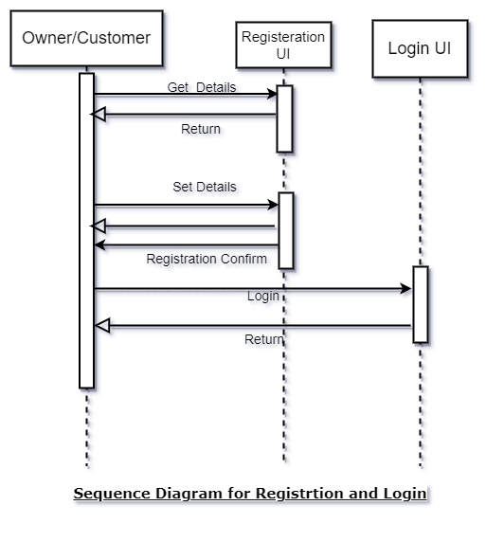
SEQUENCE DIAGRAM : Registration Login

Slide 15
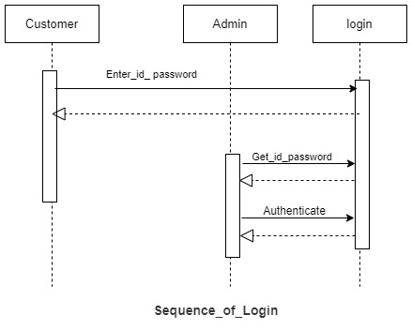
SEQUENCE DIAGRAM : Login

Slide 16
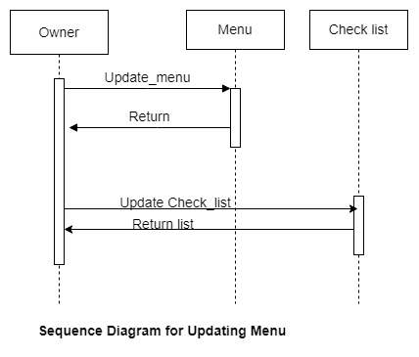
SEQUENCE DIAGRAM : Menu

Slide 17
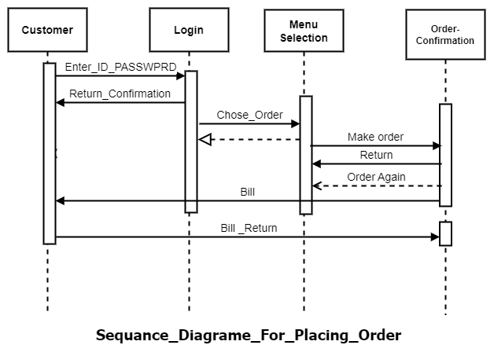
SEQUENCE DIAGRAM : Order

Slide 18
4. Objectives
Fast and Responsive System
Dynamically adjusting prices based on selection
Real - Time orders retrieval placed on the webpage
User friendly GUI
Canteen Management System
03 - 2023
18

Slide 19
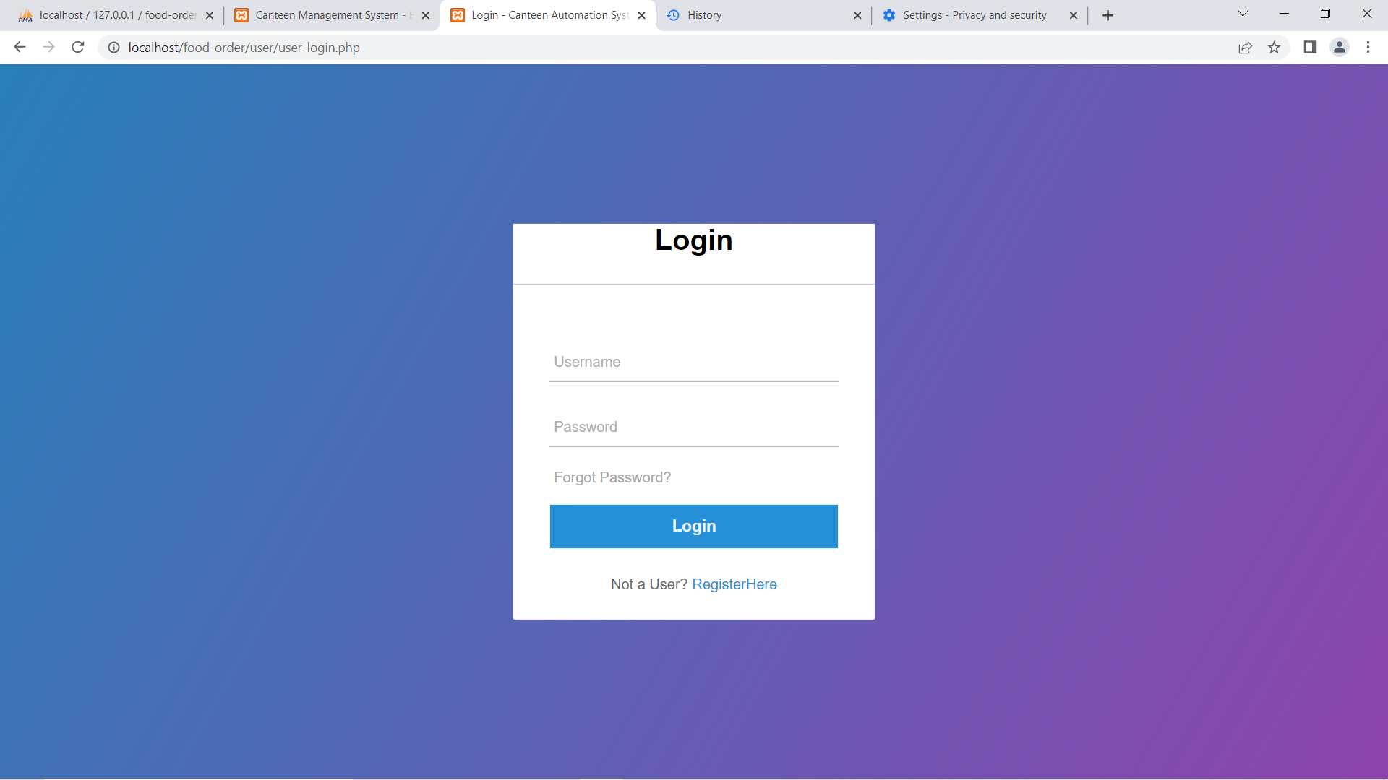
5. Design Frontend
Canteen Management System

Slide 20
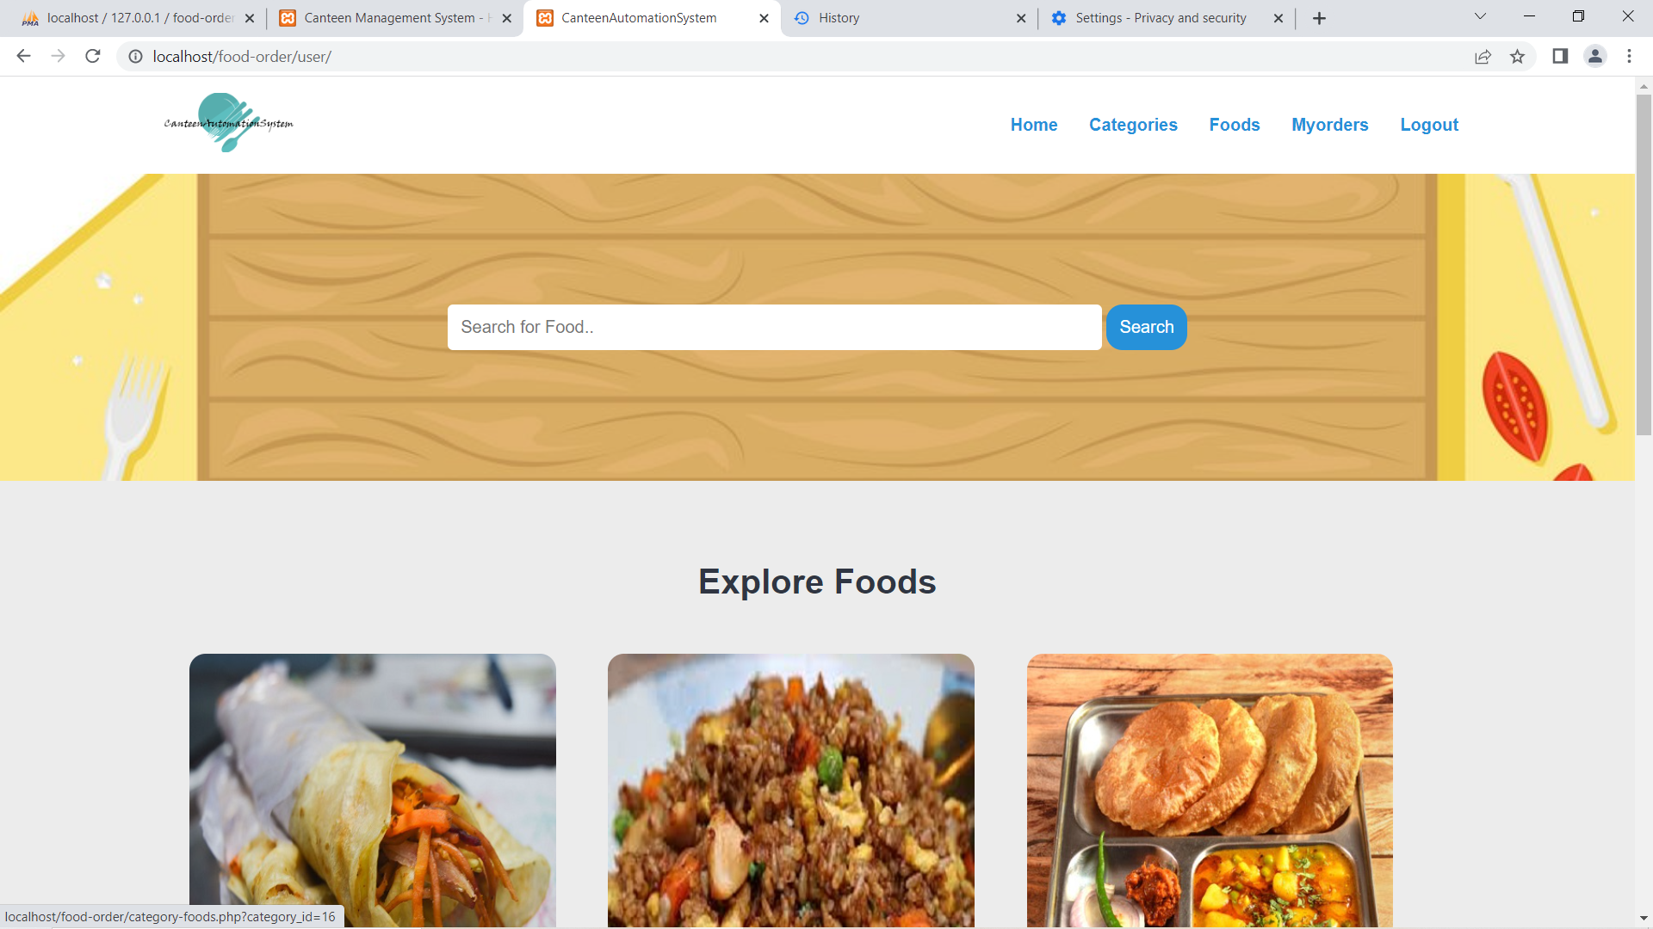

Slide 21
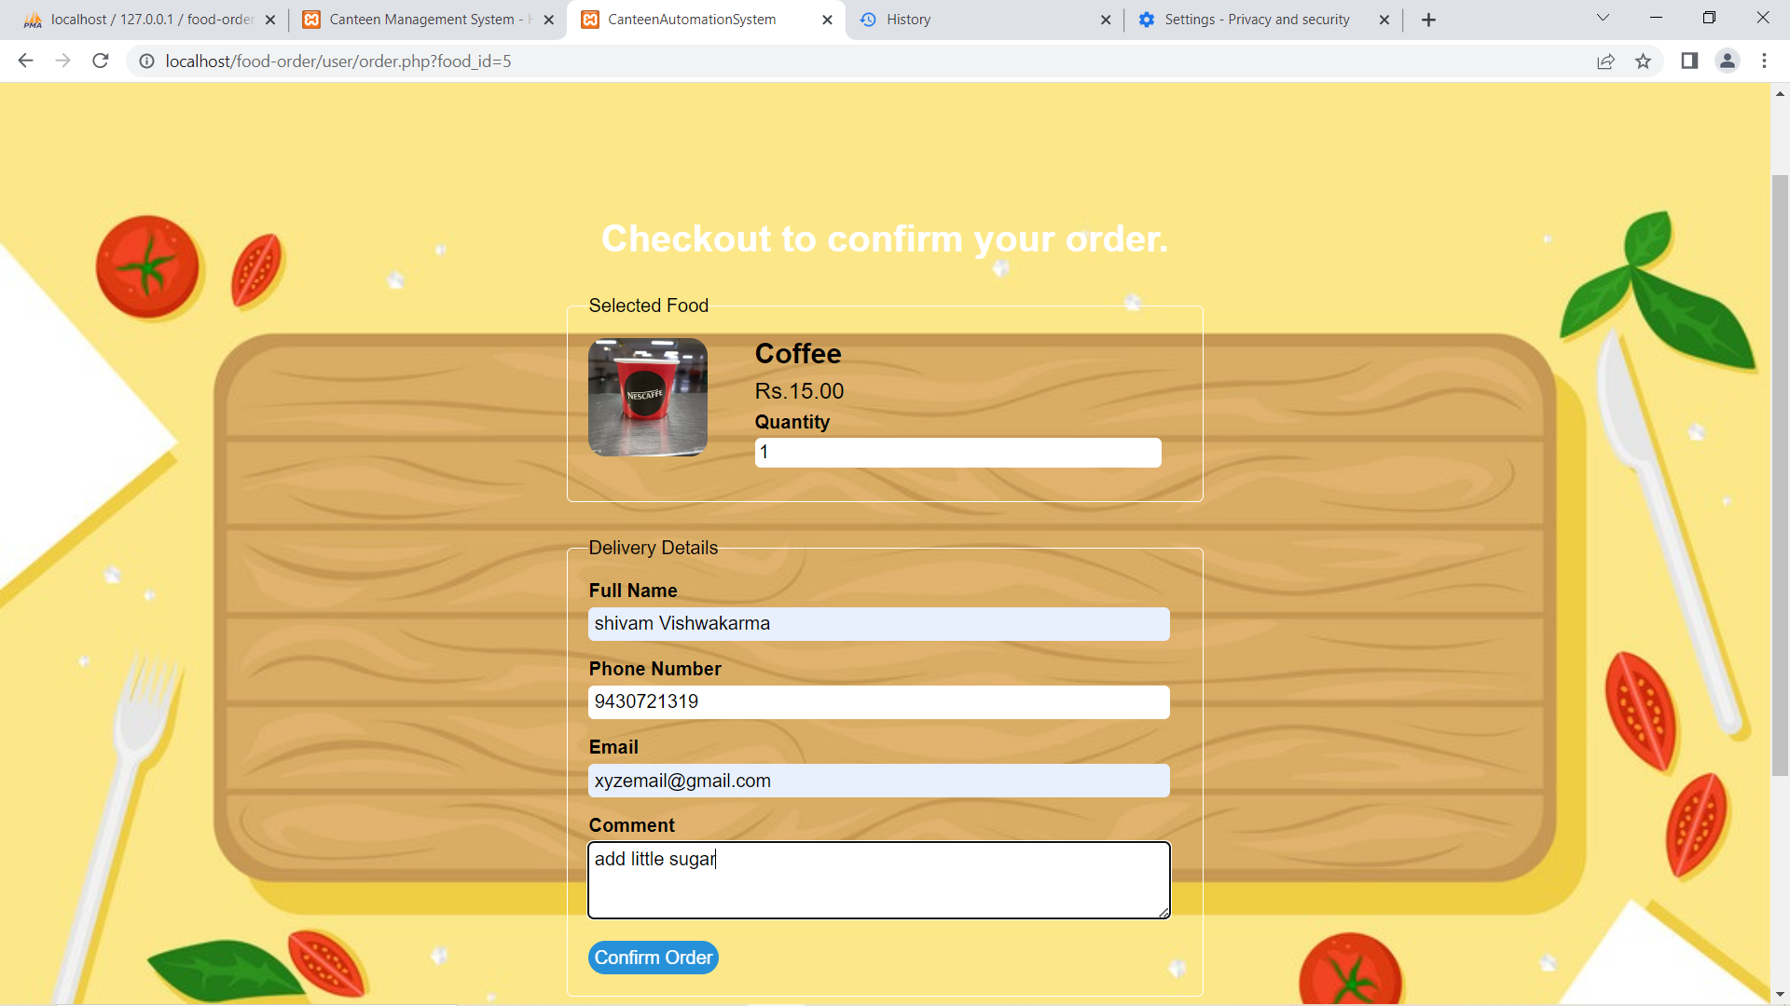

Slide 22
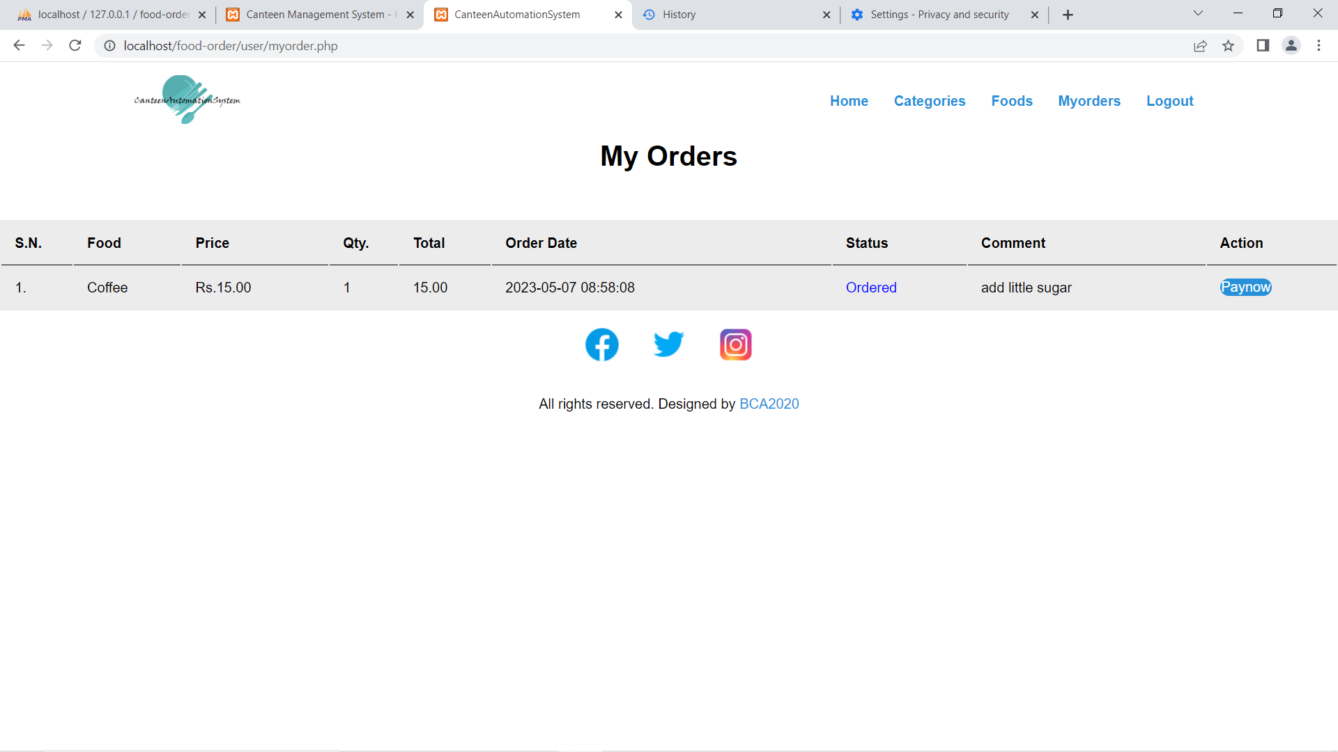

Slide 23
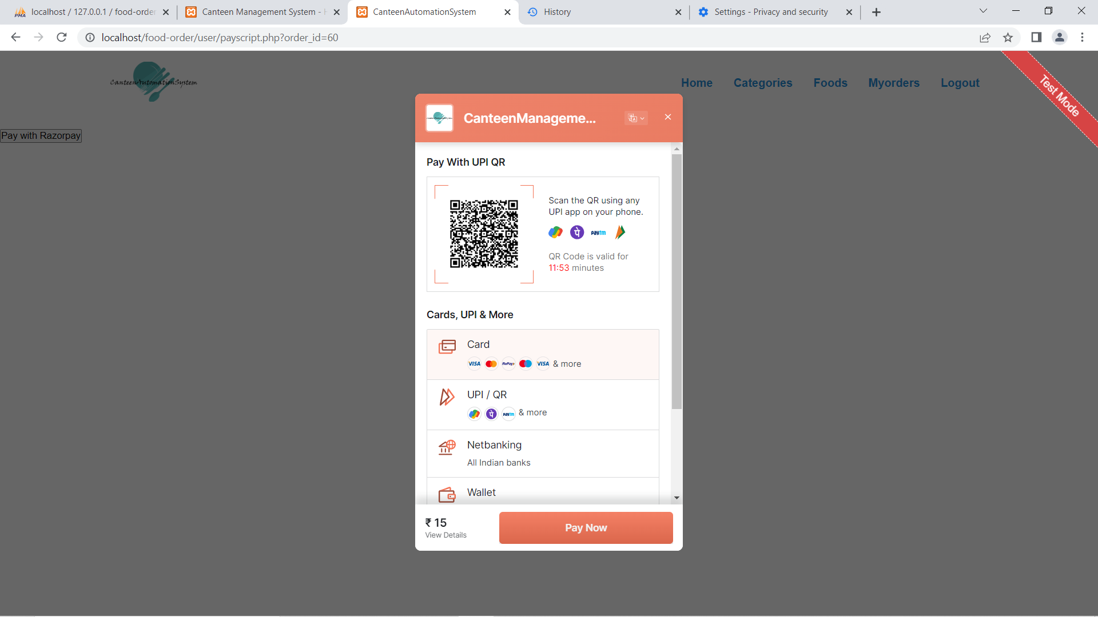

Slide 24
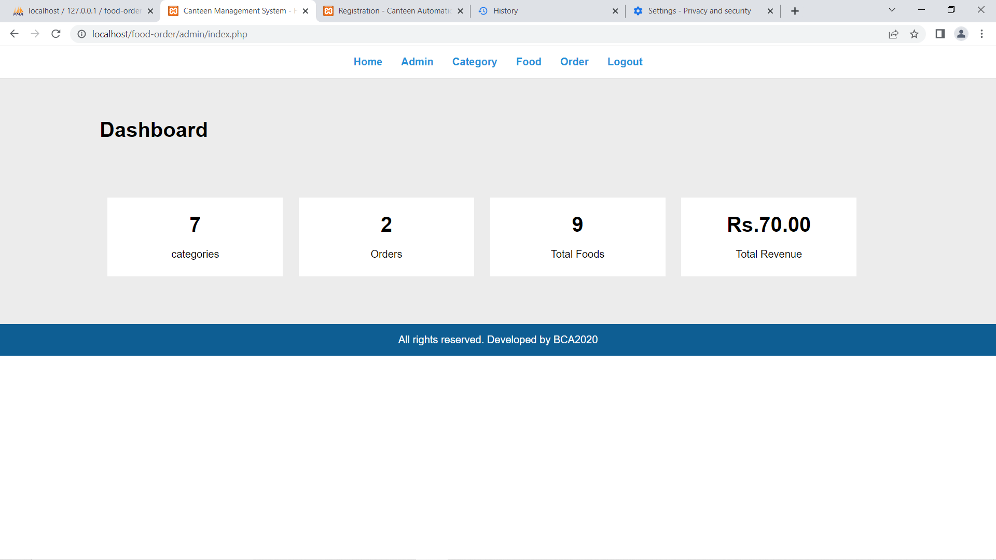

Slide 25
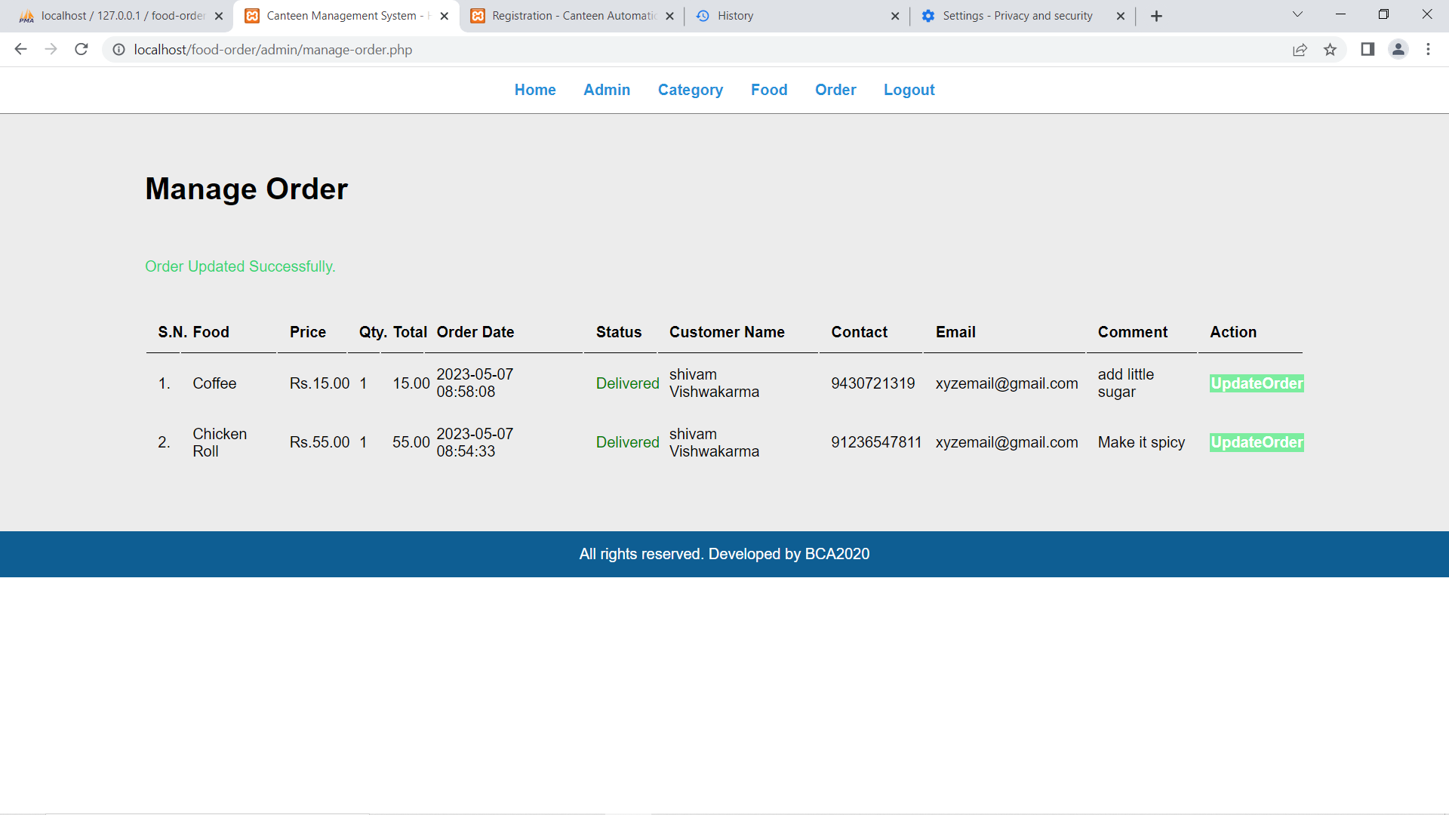

Slide 26
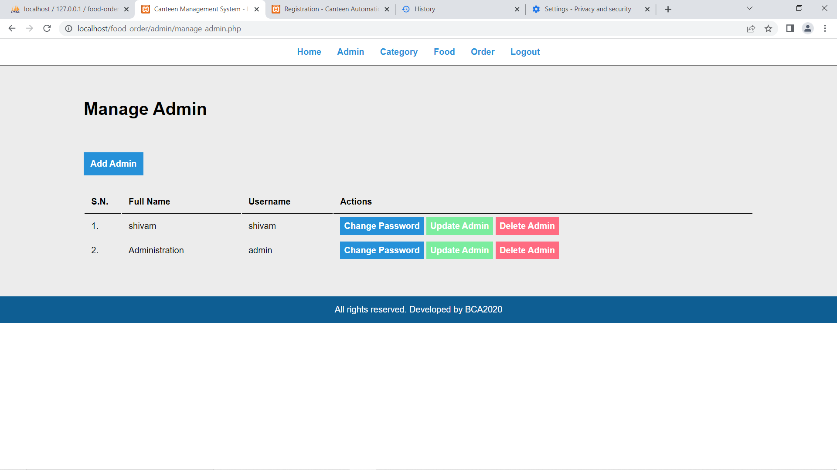

Slide 27
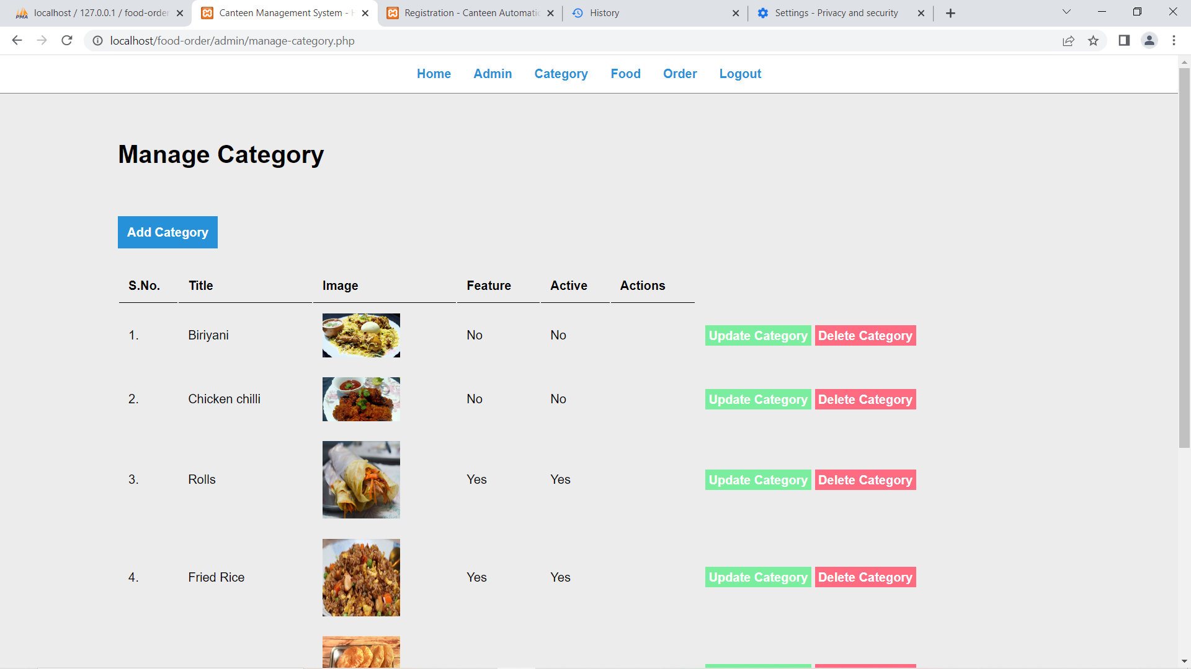

Slide 28
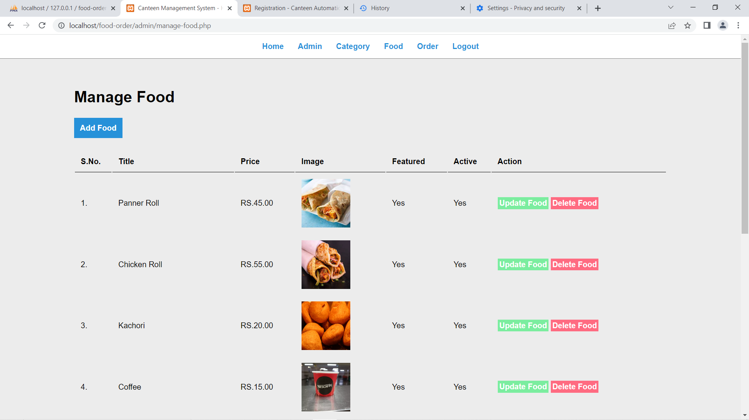

Slide 29

6. Tools and technologies
Platform - Windows 10 64-bit
Ram - 8GB
Hdd - 250GB
Frontend - HTML, CSS
Backend – php, mysql
Software – Visual Studio Code2019
Canteen Management System
03 - 2023
29

Slide 30
7. Conclusion
The approach used is a top-down
Registration – Login – Order – Payment – Confirm order – Receive Order
Detailed study of the problems and prospects
Perform efficient operations
Focuses on Overall details of Order and Revenue generated.

Slide 31
8. Future scope
Add customer & admin profiles
Host the platform on online server
printing the bill
Client & Server validation

Slide 32
“Code Never Lies, Comments sometimes do”
Ron Jeffries
Thank You

